Slide 1
Music Gamification for Beginners: Exploring Classical Music as a Game
Use Case derived from and designed for Indian Music Experience Museum
Presented at ADCx India 25 by Dr. Balamurugan, Hrithick, and Guru

Slide 2
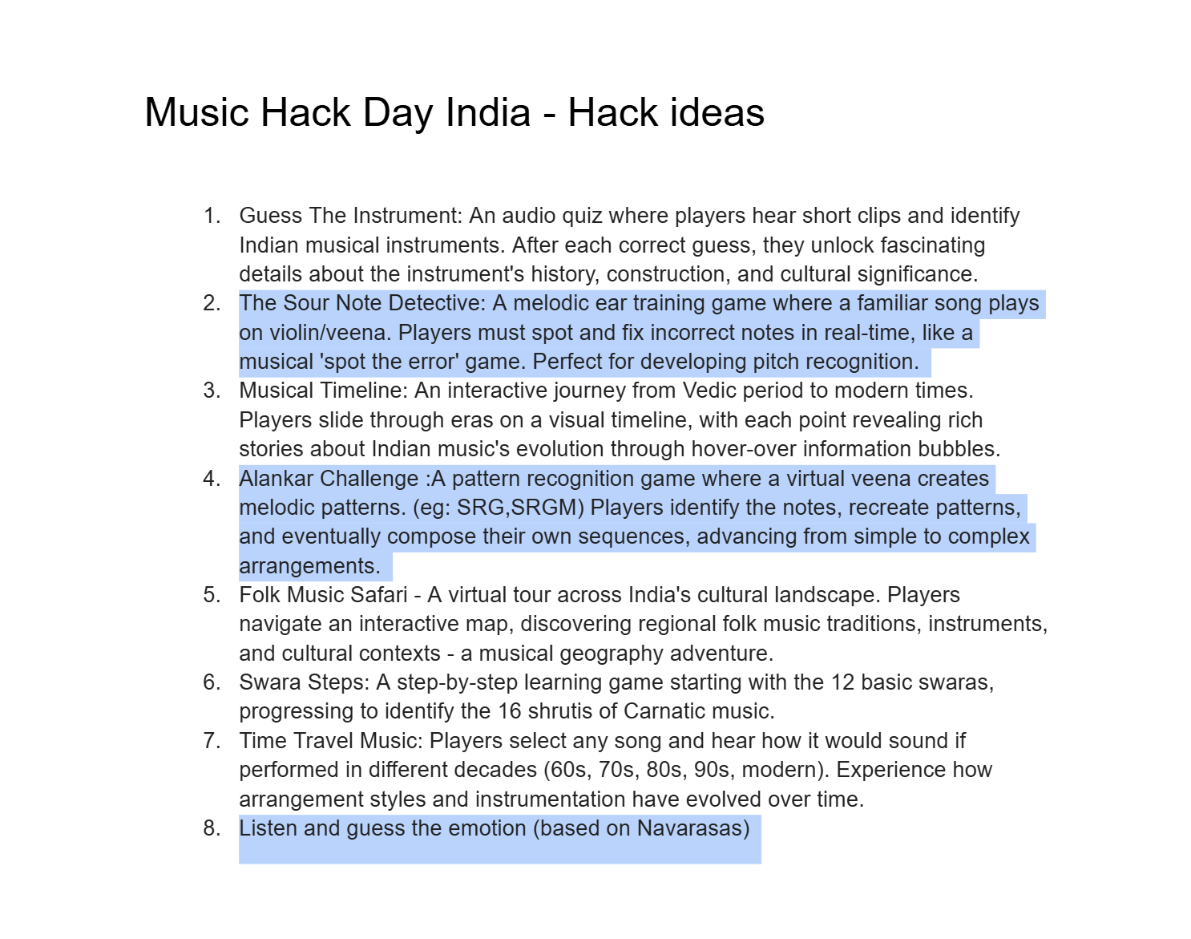
The Idea
IME’s Use Cases

Slide 3
Problem Statement!
A beginner level game trying to explore Indian classical music and instruments

Slide 4
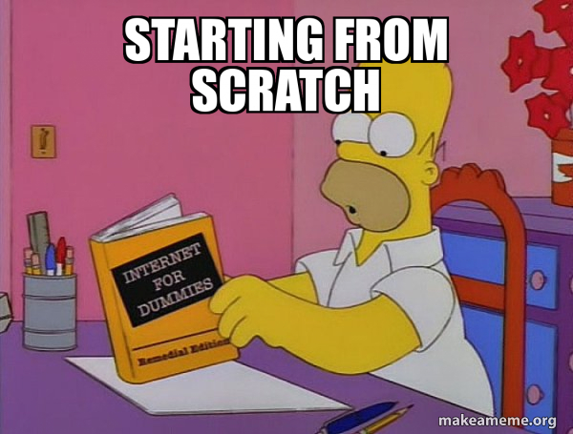
Approach
MUSIC

Slide 5
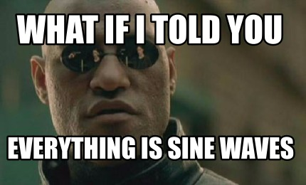

Sine wave generation
The first approach was to generate sine waves that are modulated to produce sounds like Sitar as Oscillators
But to manipulate this into generation caused a request response delay from Flask server

Slide 6
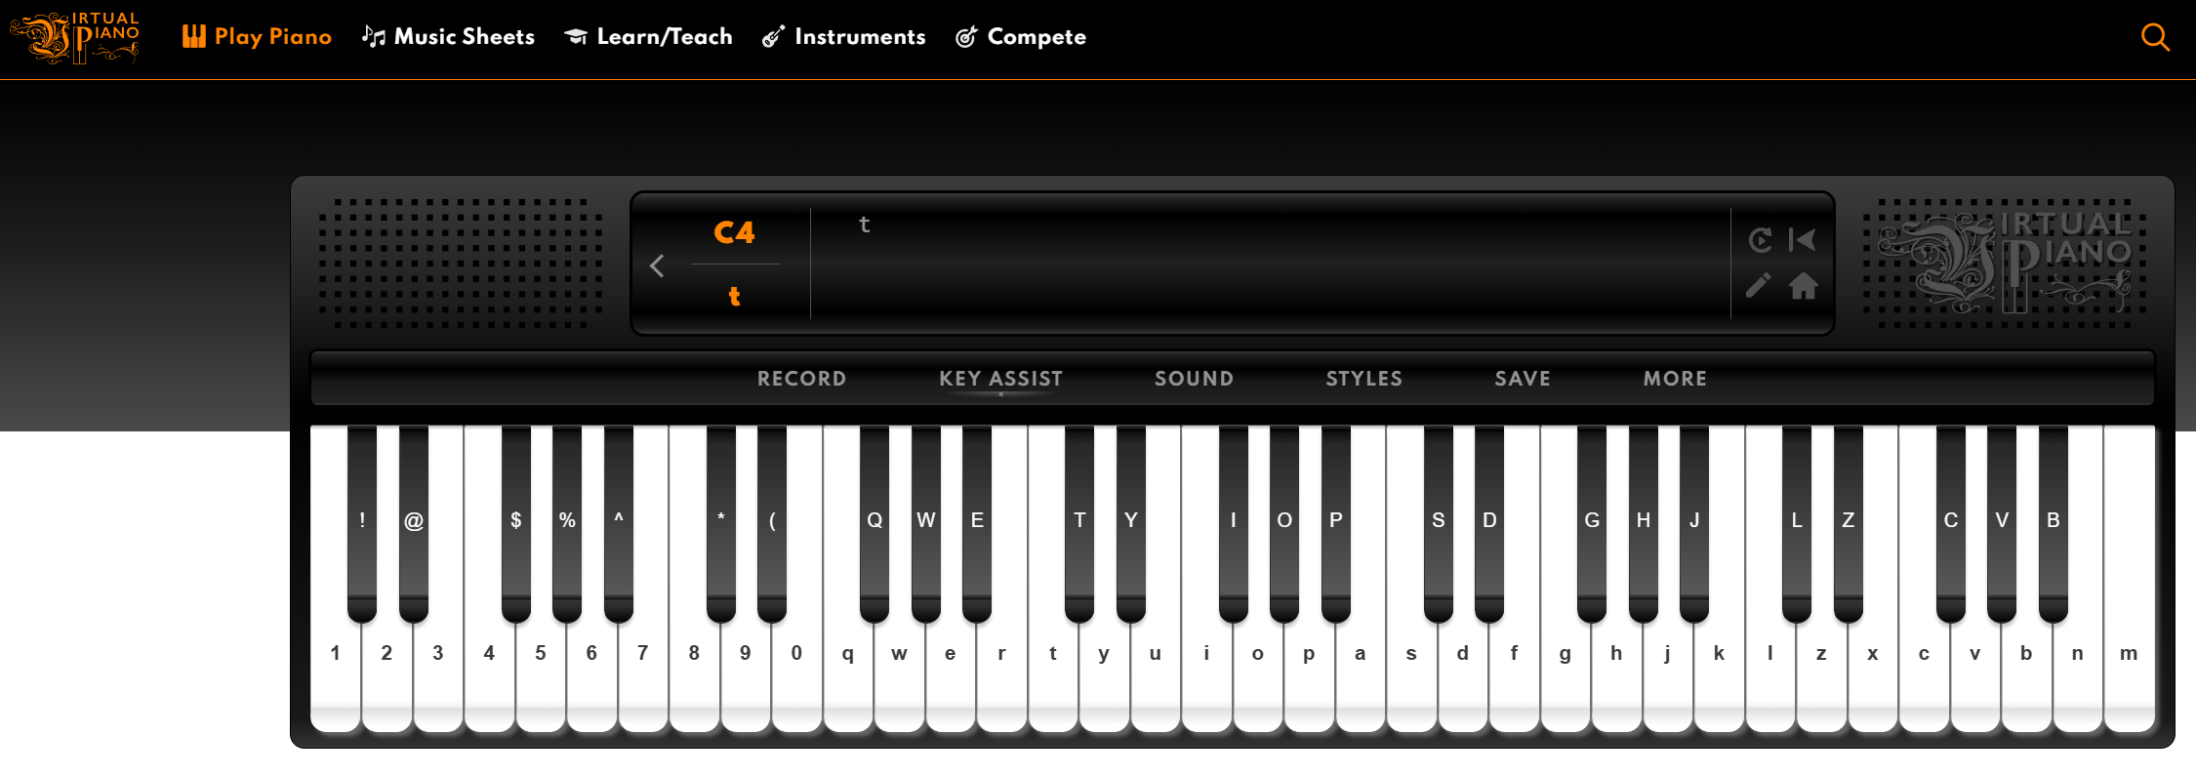
The Sound of Sitar
https://virtualpiano.net/?instr=sitar
The Next approach was to generate frequency modulated pitches from a recorded pitch of Sitar

Slide 7
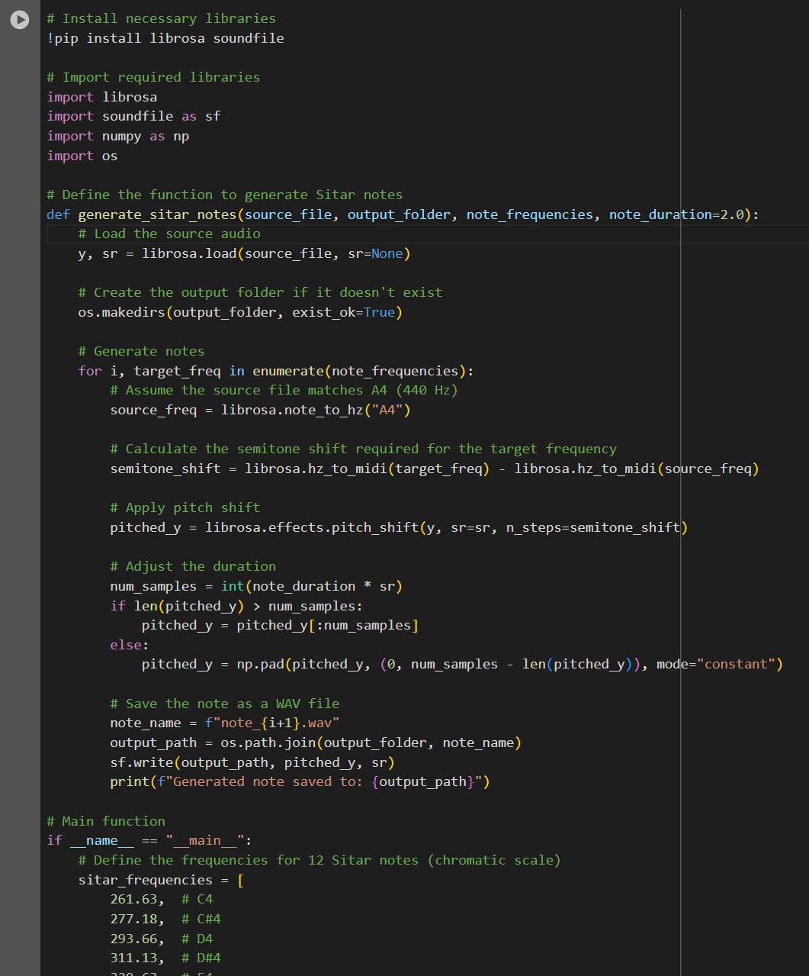
The Sound of Sitar
Using Librosa’s pitch shift effects and semitone shifts, we created the notes for all 12 semitones of sitar.

Slide 8
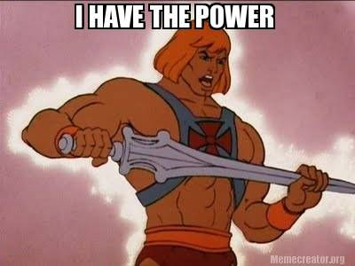
Now we got the way to create any tune anywhere. This is going to be used in many places in our idea

Slide 9

Logic behind the Problem
Backend
Create patterns with the 12 semitone frequencies
Generate patterns for Audio Visual Cues
Evaluate user interaction and response with Scoring
For composition, record key presses and durations using JS event listeners.
Make these notes cached in the browser to play with User’s interactions
Flask Server
MIR Logic
JS and Python to Manipulate

Slide 10
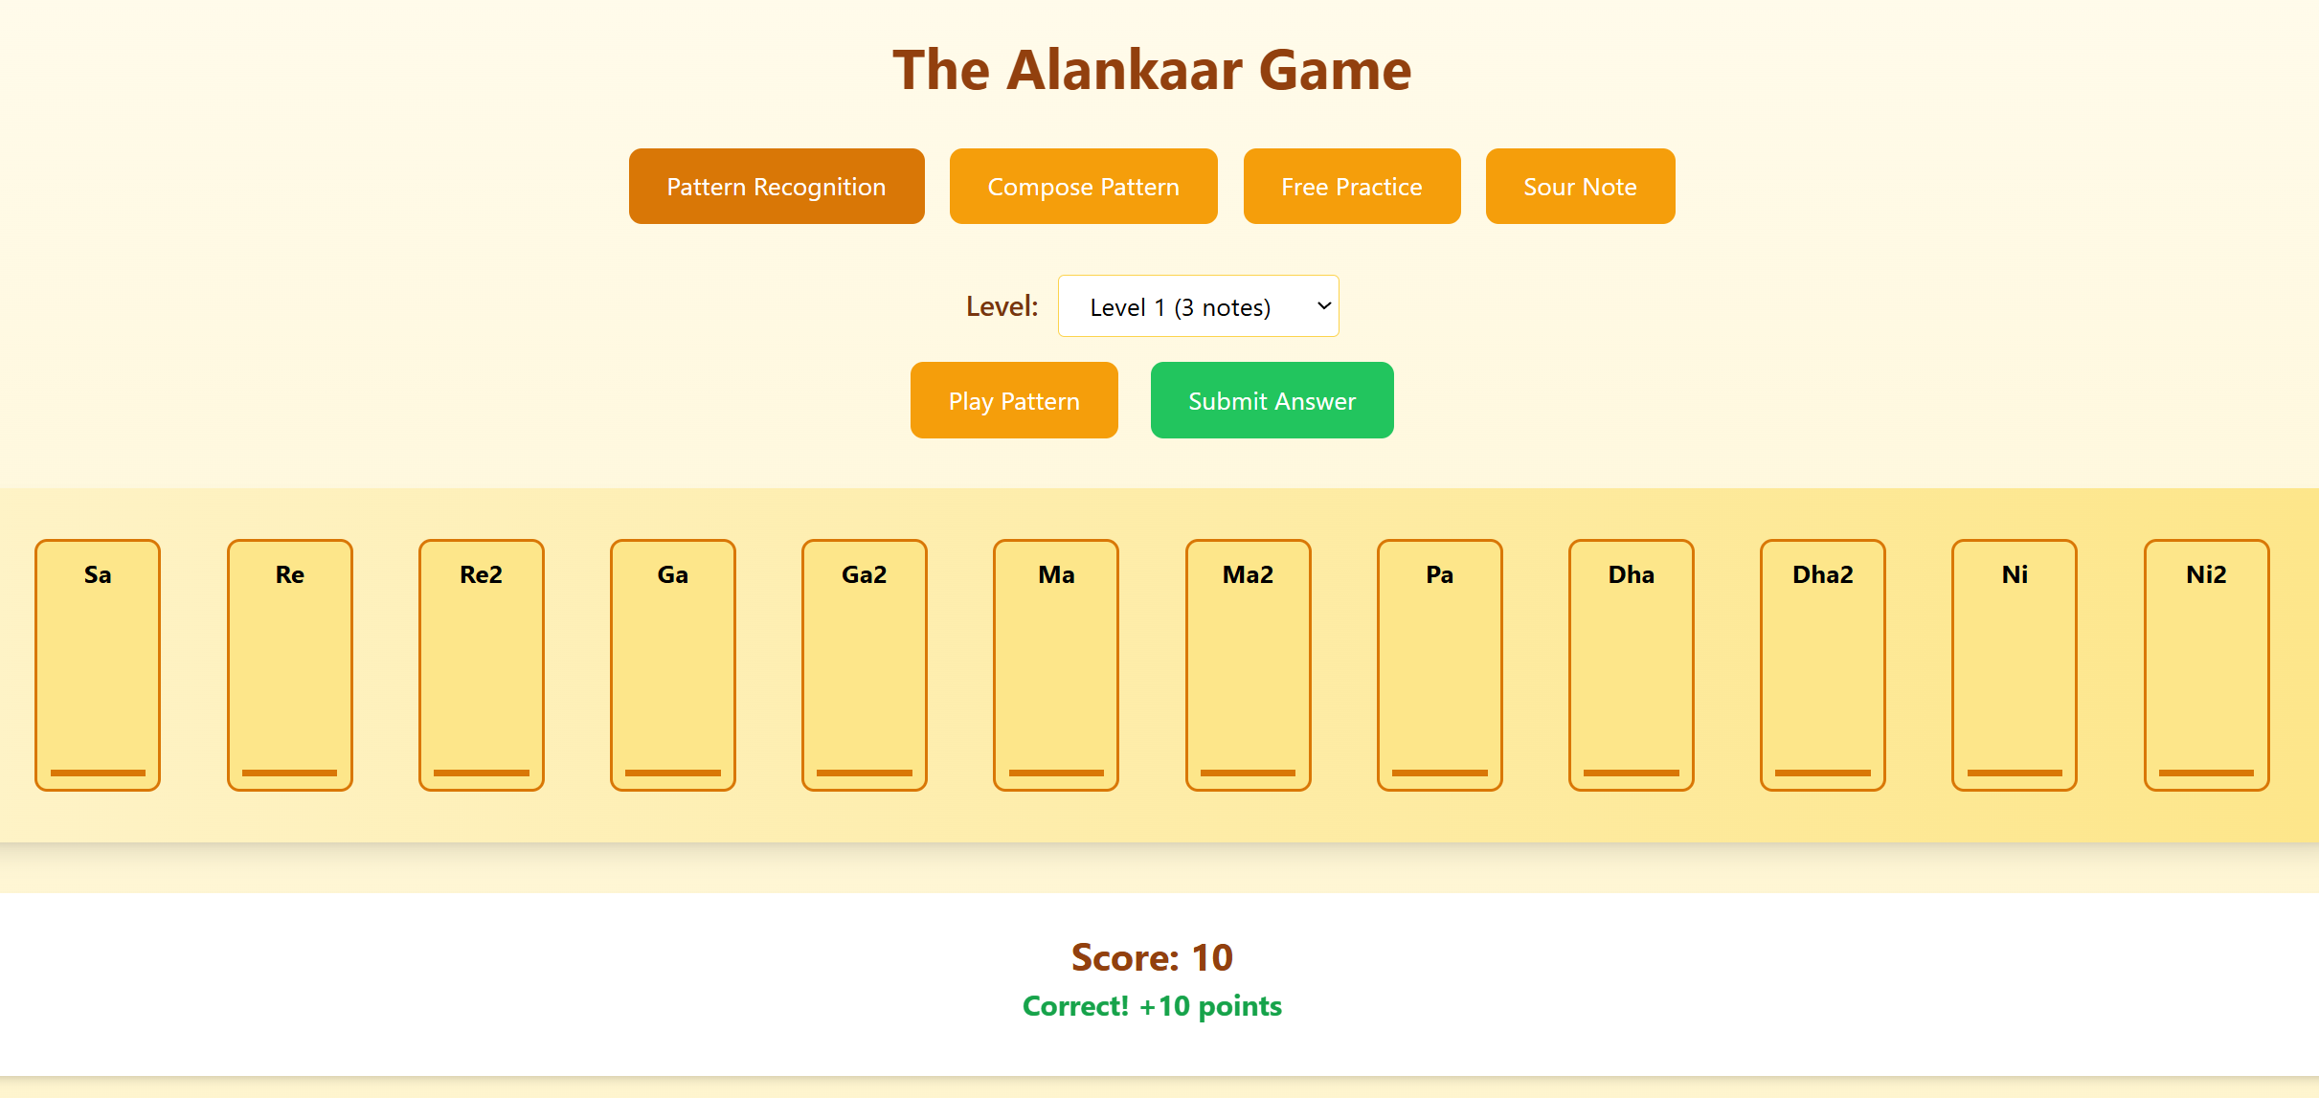
Logic behind the Problem
Frontend
Implement Audio visual cues on the browser using JS
Implement audio generation and cues cached on JS

Slide 11
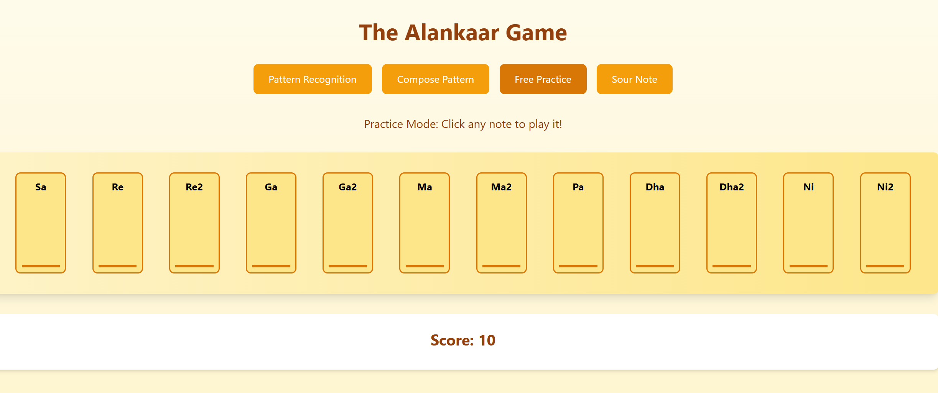
Practice at your Own Pace

Slide 12
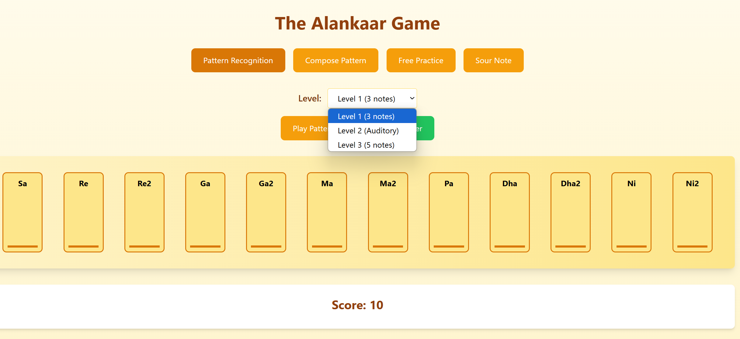
Recognize Pitch in 3 levels

Slide 13
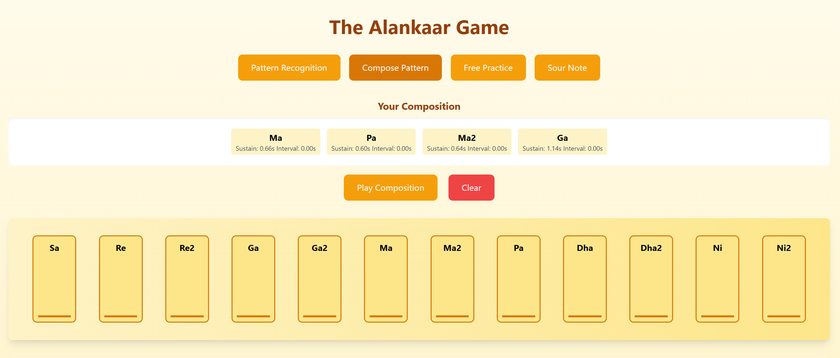
Compose your own

Slide 14

Sour Note Detection
Playing a melody and letting the user detect the note that is wrong, But in Classical

Slide 15
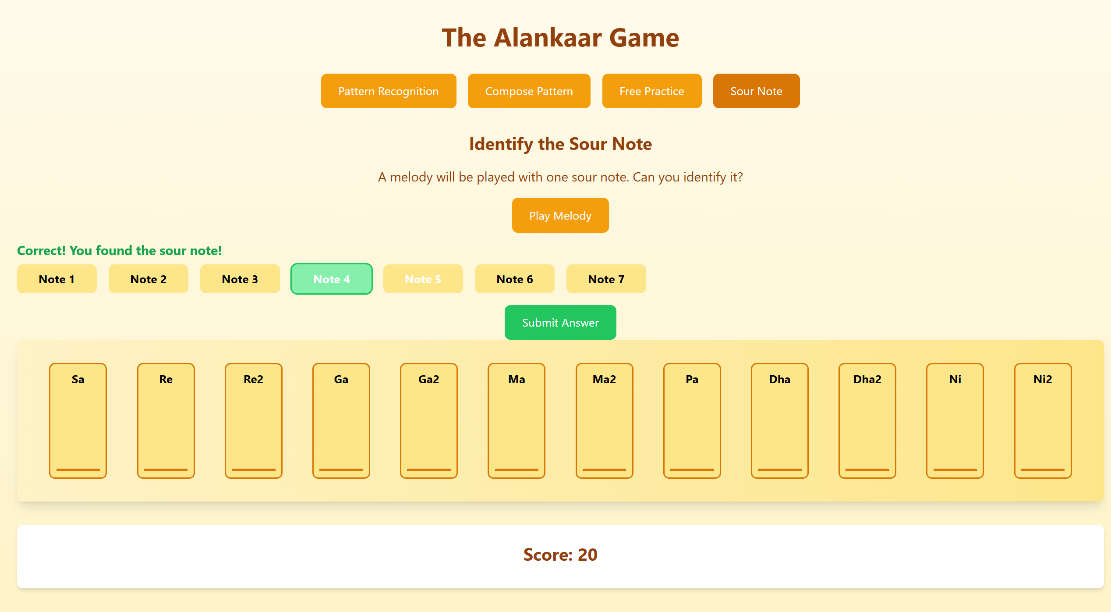
Sharpen your ears Detectives

Slide 16
NavaRasa
Mapping Emotions with Raags. Identified emotional arousal in the player to detect the emotive triggers. This game is to improve the player’s psychoacoustic arousal.
The navarasas are
shantha (peace and serenity)
veera (valour and courage),
karuna (grief and compassion
rowdra (anger)
shringara(love and romance)
bhibhatsa(disgust),
hasya (joy and mirth)
adbhutha (wonder)
bhaya (fear).

Slide 17
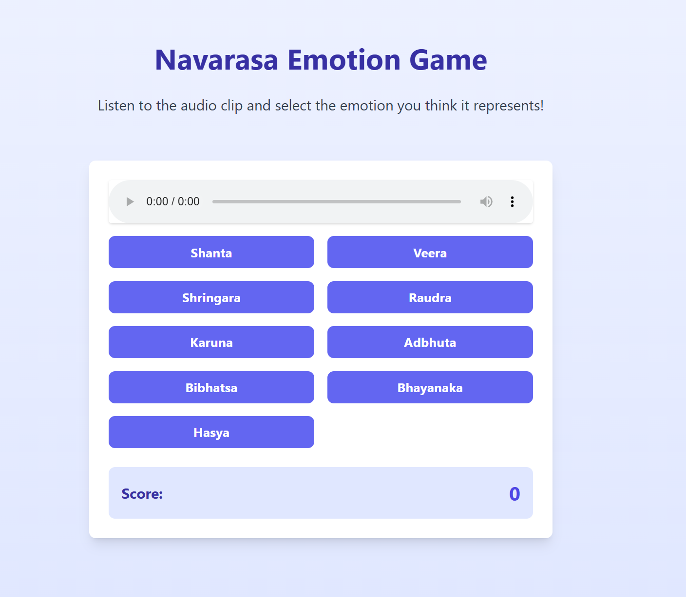
Navarasa

Slide 18
What can be done next ?
Can be incorporated to 16 Swaras and can also be improved to 22 Swaras
With Better UI, User experience can be improved
Real time Pitch Tracking can be integrated

